Slide 1

Keys in DBMS
Department of Computer Engineering and Applications

Slide 2
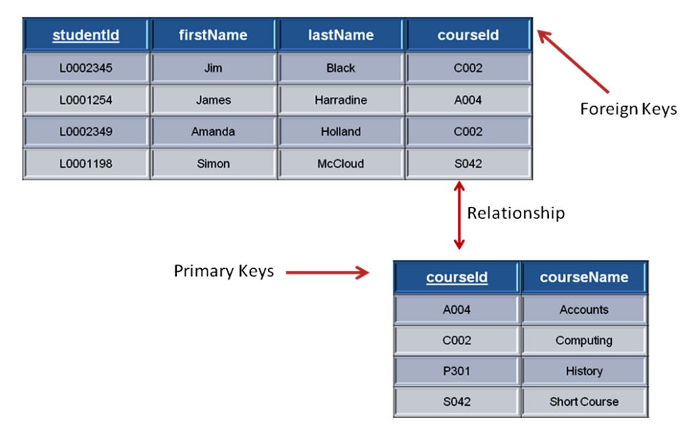
Key
A key is a set of attributes that can identify each tuple uniquely in the given relation.

Slide 3
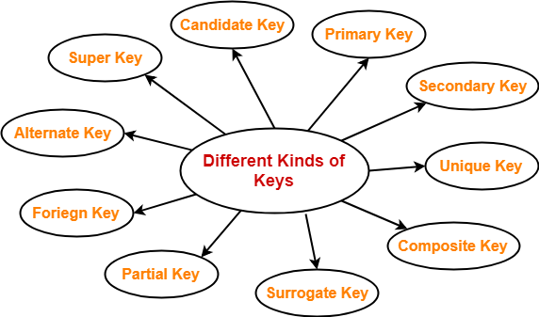
Different Types Of Keys in DBMS-

Slide 4
1. Super Key-
A super key is a set of attributes that can identify each tuple uniquely in the given relation.
A super key is not restricted to have any specific number of attributes.
Thus, a super key may consist of any number of attributes.
Consider the following Student schema-
Student ( roll , name , sex , age , address , class , section )
Given below are the examples of super keys since each set can uniquely identify each student in the Student table-
( roll , name , sex , age , address , class , section )
( class , section , roll )
(class , section , roll , sex )
( name , address )

Slide 5
2. Candidate Key-
A set of minimal attribute(s) that can identify each tuple uniquely in the given relation is called as a candidate key.
Consider the following Student schema-
Student ( roll , name , sex , age , address , class , section )
Given below are the examples of candidate keys since each set consists of minimal attributes required to identify each student uniquely in the Student table-
( class , section , roll )
( name , address )

Slide 6
NOTES-
All the attributes in a candidate key are sufficient as well as necessary to identify each tuple uniquely.
Removing any attribute from the candidate key fails in identifying each tuple uniquely.
The value of candidate key must always be unique.
The value of candidate key can never be NULL.
It is possible to have multiple candidate keys in a relation.
Those attributes which appears in some candidate key are called as prime attributes.

Slide 7
3. Primary Key-
A primary key is a candidate key that the database designer selects while designing the database.
Primary key is used to uniquely identify a record in relation.
NOTES-
The value of primary key can never be NULL.
The value of primary key must always be unique.
The values of primary key can never be changed i.e. no updation is possible.
A relation is allowed to have only one primary key.

Slide 8
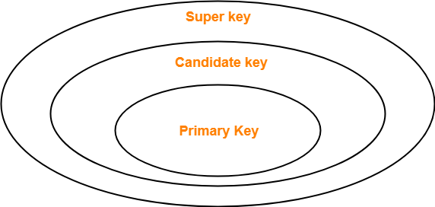
Relationship between Super Key, Primary Key and Candidate Key

Slide 9
4. Alternate Key-
Out of all candidate keys, only one gets selected as primary key, remaining keys are known as alternate or secondary keys.

Slide 10
5. Foreign Key-
Foreign keys are the columns of a table that points to the primary key of another table. They act as a cross-reference between tables.
In a company, every employee works in a specific department, and employee and department are two different entities. So we can't store the information of the department in the employee table. That's why we link these two tables through the primary key of one table.
We add the primary key of the DEPARTMENT table, Department_Id as a new attribute in the EMPLOYEE table.
Now in the EMPLOYEE table, Department_Id is the foreign key, and both the tables are related

Slide 11
Foreign key references the primary key of the table.
Foreign key can take only those values which are present in the primary key of the referenced relation.
Foreign key may have a name other than that of a primary key.

Slide 12
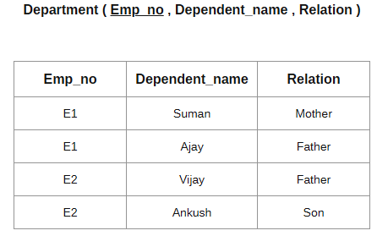
6. Partial Key-
Partial key is a key using which all the records of the table can not be identified uniquely.
However, a bunch of related tuples can be selected from the table using the partial key.

Slide 13
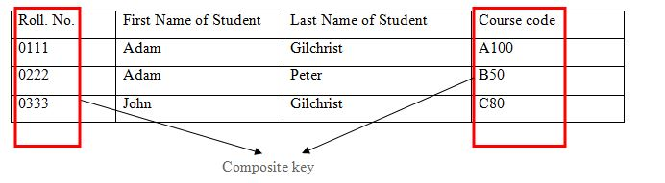
7. Composite Key-
Composite Key has at-least two or more than two attributes which specially identifies the occurrence of an entity.
In the above example the Roll No. and Course Code is combined to uniquely identify the record in relation.

Slide 14
8. Unique Key-
Unique key is a key with the following properties-
It is unique for all the records of the table.
Once assigned, its value can not be changed i.e. it is non-updatable.
It may have a NULL value.
The best example of unique key is Adhaar Card Numbers.

Slide 15
9. Surrogate Key-
Surrogate key is a key with the following properties-
It is unique for all the records of the table.
It is updatable.
It can not be NULL i.e. it must have some value.
Mobile Number of students in a class where every student owns a mobile phone

Slide 16
10. Secondary Key-
Secondary key is required for the indexing purpose for better and faster searching.

